Slide 1
Advanced OS - Kernels
Manish Shrivastava

Slide 2
Computer OS components
Hardware – provides basic computing resources (CPU, memory, I/O devices).
Operating system – controls and coordinates the use of the hardware among the various application programs for the various users.
Applications programs – define the ways in which the system resources are used to solve the computing problems of the users (compilers, database systems, video games, business programs).
Users (people, machines, other computers).

Slide 3
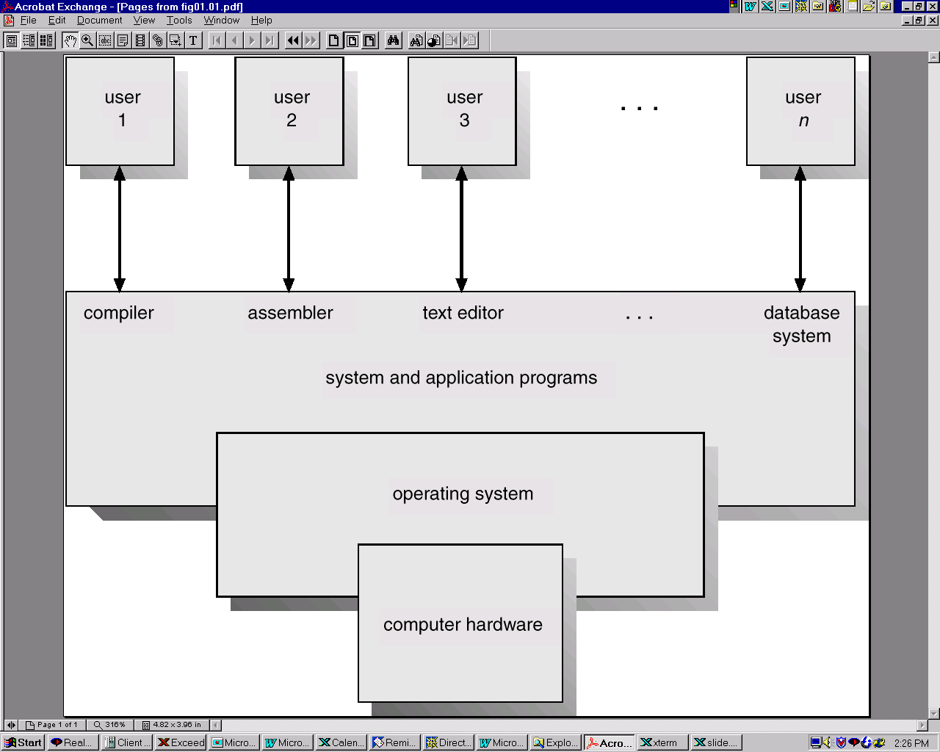
Computer OS components

Slide 4
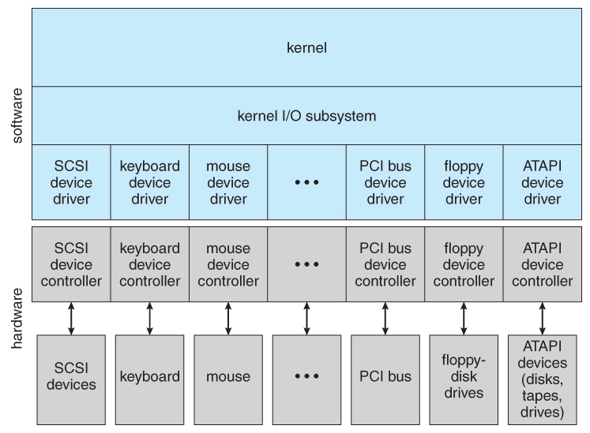
Kernel

Slide 5
Types of Kernels
Monolithic Kernel: Kernels where the user services and the kernel services are implemented in the same memory space
Microkernel: the user services and kernel services are implemented into different spaces
Hybrid Kernel: Duh!!

Slide 6
Early structure: Monolithic
Traditionally, OS’s (like UNIX) were built as a monolithic entity:
user programs
everything
OS
hardware

Slide 7
Monolithic design
Major advantage:
cost of module interactions is low (procedure call)
Disadvantages:
hard to understand
hard to modify
unreliable (no isolation between system modules)
hard to maintain
What is the alternative?
find a way to organize the OS in order to simplify its design and implementation

Slide 8
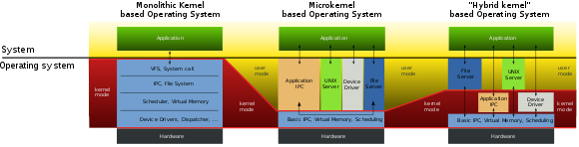

Slide 9
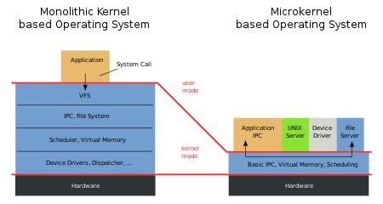

Slide 10
Layering
The traditional approach is layering
implement OS as a set of layers
each layer presents an enhanced ‘virtual machine’ to the layer above
The first description of this approach was Dijkstra’s THE system
Layer 5: Job Managers
Execute users’ programs
Layer 4: Device Managers
Handle devices and provide buffering
Layer 3: Console Manager
Implements virtual consoles
Layer 2: Page Manager
Implements virtual memories for each process
Layer 1: Kernel
Implements a virtual processor for each process
Layer 0: Hardware
Each layer can be tested and verified independently

Slide 11
Problems with layering
Imposes hierarchical structure
but real systems are more complex:
file system requires VM services (buffers)
VM would like to use files for its backing store
strict layering isn’t flexible enough
Poor performance
each layer crossing has overhead associated with it
Disjunction between model and reality
systems modeled as layers, but not really built that way

Slide 12
Hardware Abstraction Layer
An example of layering in modern operating systems
Goal: separates hardware-specific routines from the “core” OS
Provides portability
Improves readability
Core OS
(file system,
scheduler,
system calls)
Hardware Abstraction
Layer
(device drivers,
assembly routines)

Slide 13
Microkernels
Popular in the late 80’s, early 90’s
recent resurgence of popularity
Goal:
minimize what goes in kernel
organize rest of OS as user-level processes
This results in:
better reliability (isolation between components)
ease of extension and customization
poor performance (user/kernel boundary crossings)
First microkernel system was Hydra (CMU, 1970)
Follow-ons: Mach (CMU), Chorus (French UNIX-like OS), OS X (Apple), in some ways NT (Microsoft)

Slide 14
Microkernel structure illustrated
user processes
firefox
powerpoint
user mode
apache
photoshop
itunes
word
file system
network
system processes
paging
threads
scheduling
communication
Kernel mode
microkernel
low-level VM
processor control
protection
hardware
14

Slide 15
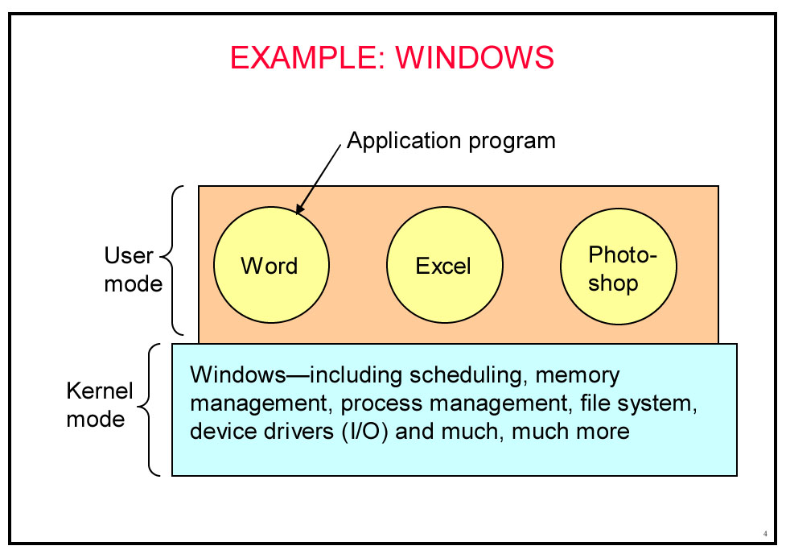
From Andy Tanenbaum

Slide 16
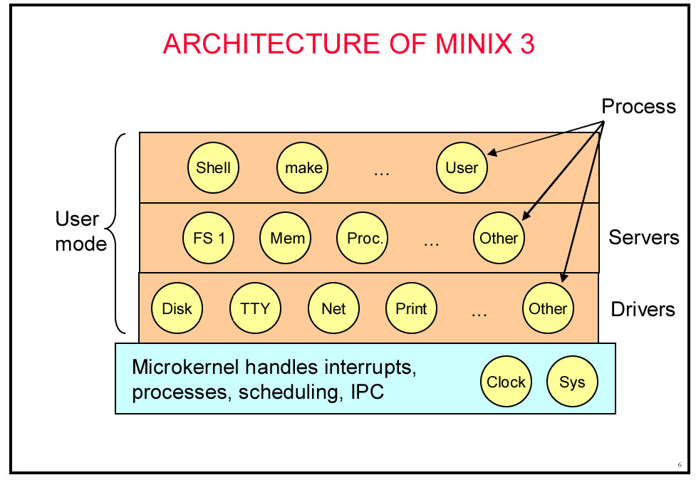
From Andy Tanenbaum

Slide 17
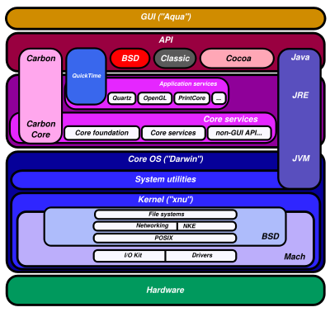
Mac OS X

Slide 18
The Linux Kernel
Manish Shrivastava

Slide 19
Monolithic?
What is a monolithic program?
What is a Monolithic Kernel?

Slide 20
Process?
What is a process?
Is kernel a process?

Slide 21
Process?
What is a process?
Is kernel a process?
No!
Init is just the first process; it does not manage any processes or threads. It does create some, using the kernel syscalls fork() and exec.
It is a Process Manager without being a process

Slide 22
Kernel vs. Application Coding
Two major differences:
The core kernel has no standard libraries
The core kernel must be a monolithic, statically linked library
No standard libraries:
No libc (malloc, pthreads, string handling, etc.)
Partly because of chicken/egg situation
Also, standard libraries can be too slow
No dynamic loading of shared libraries for the core kernel

Slide 23
Two Big Problems
A totally static kernel would be enormous
About 20 million lines of code in 2015
Most of this is hardware drivers that are never used on any given platform
Programmers rely on “library” functions for efficiency and correctness
E.g., things like data structures, sleeping routines, etc.
What libraries to use? (hint: not glibc)
Kernel code has to be entirely self-contained
Also, chicken+egg problem, as glibc functions may in turn invoke the kernel via system calls

Slide 24
First Solution: Loadable Kernel Modules
Kernel modules are kernel code that can be loaded dynamically:
Can be loaded/unloaded whenever
Runs in kernel mode
Can access exported kernel variables and functions
Can export variables and functions to kernel or other modules

Slide 25
Kernel and Kernel Modules
Often, if you want to add something to the kernel you need to rebuild the kernel and reboot.
A “loadable kernel module” (LKM) is an object file that extends the base kernel.
Exist in most OSes
Including Windows, FreeBSD, Mac OS X, etc.
Modules get added and removed as needed
To save memory, add functionality, etc.

Slide 26
Why Kernel Modules
Linux is a monolithic kernel. All functionality is compiled into the same static binary that is loaded into memory on boot.
Without modules, the entire kernel would need to be loaded into memory to boot a node. Problems?
Waste of memory (embedded systems)
Slower boot time
Larger trusted computing base (TCB), more room for bugs

Slide 27
What are Kernel Modules used for?
What pieces of code do we think might not be needed on every system that the kernel boots on?
Device Drivers
Architecture-specific code
Lines of code (just .c files) for:
Device Drivers: 1,583,159
Everything else: 1,003,777
(Includes all of the architectures that we’re not using!)

Slide 28
What are Kernel Modules used for?
Beyond space savings, what else might modules be useful for?
“Out-of-tree” functionality that is not accepted into “mainline” kernel
Allowing users to load custom functionality at runtime
Configuring/patching a running system without requiring a reboot

Slide 29
Modular?
What does it mean to be modular (exactly)?
How is that beneficial?
How would a Modular kernel differ from a Monolithic one?

Slide 30
Linux Kernel Modules
In general must be licensed under a free license.
Doing otherwise will taint the whole kernel.
A tainted kernel sees little support.
Might be a copyright problem if you redistribute.
The Linux kernel changes pretty rapidly, including APIs etc.
This can make it a real chore to keep LKMs up to date.
Also makes a tutorial a bit of a pain.

Slide 31
Module Implementation
Must define:
An initialization function called on load
An exit function called on unload
The init function must be self contained!
Must unwind actions if initialization cannot complete successfully
E.g. if you kmalloc() space but don’t free it, that physical memory is now lost (until system restart)
You can also pass parameters to modules at load time.

Slide 32
Creating a module
All modules need to define functions that are to be run when:
The module is loaded into the kernel
The module is removed from the kernel
We just write C code (see next slide)
We need to compile it as a kernel module.
We invoke the kernel’s makefile.
sudo make –C /lib/modules/xxx/build M=$PWD modules
This makes (as root) using the makefile in the path specified.
I think it makes all C files in the directory you started in
Creates .ko (rather than .o) file
Xxx is some kernel version/directory

Slide 33
Simple module
#include <linux/init.h>
#include <linux/module.h>
#include <linux/kernel.h>
MODULE_LICENSE("Dual BSD/GPL");
static int hello_init(void) {
printk("<1> Hello World!\n");
return 0;
}
static void hello_exit(void) {
printk("<1> Bye world!\n");
}
module_init(hello_init);
module_exit(hello_exit);
MODULE_LICENSE
Required.
Short list of allowed licenses.
Printk()
Kernel print.
Prints message to console and to log.
<1> indicates high priority message, so it gets logged.
Module_init()
Tells system what module to call when we first load the module.
TIMTOWTDI
Module_exit()
Same but called when module released.

Slide 34
Modules: Listing, loading and removing
From the command line:
lsmod
List modules.
insmod
Insert module into kernel
Adds to list of available modules
Causes function specified by module_init() to be called.
rmmod
Removes module from kernel

Slide 35
lsmod
Module Size Used by memory 10888 0 hello 9600 0 binfmt_misc 18572 1 bridge 63776 0 stp 11140 1 bridge bnep 22912 2 video 29844 0

Slide 36
insmod
Very (very) simple
insmod xxxxx.ko
Says to insert the module into the kernel

Slide 37
Other (better) way to load a module
Modprobe is a smarter version of insmod.
Actually it’s a smarter version of insmod, lsmod and rmmod…
It can use short names/aliases for modules
It will first install any dependent modules
We’ll use insmod for the most part
But be aware of modprobe
[3]

Slide 38
So?
#include <linux/init.h>
#include <linux/module.h>
#include <linux/kernel.h>
MODULE_LICENSE("Dual BSD/GPL");
static int hello_init(void) {
printk("<1> Hello World!\n");
return 0;
}
static void hello_exit(void) {
printk("<1> Bye world!\n");
}
module_init(hello_init);
module_exit(hello_exit);
When insmod, log file gets a “Hello World!”
When rmmod, that message prints to log (and console…)
It’s not the name, it’s the module_init().

Slide 39
Modules?
There are a number of different reasons one might have a module
But the main one is to create a device driver
It’s not realistic for Linux to have a device driver for all possible hardware in memory all at once.
Would be too much code, requiring too much memory.
So we have devices as modules
Loaded as needed.

Slide 40
Device driver (Thanks Wikipedia!)
A device driver is a computer program allowing higher-level computer programs to interact with a hardware device.
A driver typically communicates with the device through the computer bus or communications subsystem to which the hardware connects.
When a calling program invokes a routine in the driver, the driver issues commands to the device.
Drivers are hardware-dependent and operating-system-specific.

Slide 41
Devices in Linux (1/2)
There are special files called “device files” in Linux.
A user can interact with it much like a normal file.
But they generally provide access to a physical device.
They are generally found in /dev and /sys
/dev/fb is the frame buffer
/dev/ttyS0 is one of the serial ports
Not all devices files correspond to physical devices.
Pseudo-devices.
Provide various functions to the programmer
/dev/null
Accepts and discards all input; produces no output.
/dev/zero
Produces a continuous stream of NULL (zero value) bytes.
etc.
crw-rw---- 1 root dialout 4, 64 Jun 20 13:01 ttyS0

Slide 42
Devices in Linux (2/2)
Pretty clearly you need a way to connect the device file to the actual device
Or pseudo device for that matter
We want to be able to “fake” this by writing functions that handle the file I/O.
So we need to associate functions with all the things we can do with a file.
Open, close.
Read, write.
Today we’ll talk about all that…

Slide 43
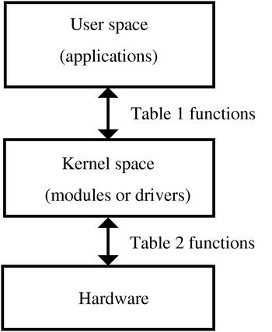
Kernel vs. User space
User Space
End-user programs. They use the kernel to interface to the hardware.
Kernel Space
Provides a standard (and hopefully multi-user secure) method of using and sharing the hardware.
Private function member might be a good analogy.
[1]

Slide 44
What is a “device”?
Linux devices are accessed from user space in exactly the same way files are accessed.
They are generally found in /dev and /sys
To link normal files with a kernel module, each device has a “major number”
Each device also has a “minor number” which can be used by the device to distinguish what job it is doing.
% ls -l /dev/fd0 /dev/fd0u1680
brwxrwxrwx 1 root floppy 2, 0 Jul 5 2000 /dev/fd0
brw-rw---- 1 root floppy 2, 44 Jul 5 2000 /dev/fd0u1680
Two floppy devices. They are actually both the same bit of hardware using the same driver
(major number is 2), but one is 1.68MB the other 1.44.

Slide 45
Creating a device
mknod /dev/memory c 60 0
Creates a device named /dev/memory
Major number 60
Minor number 0
Minor numbers are passed to the driver to distinguish different hardware with the same driver.
Or, potentially, the same hardware with different parameters (as the floppy example)

Slide 46
Second Solution: Kernel “Libraries”
Kernel libraries re-implement a lot of the functionality programmers expect in user space
Are statically compiled into the kernel
Automatically available just by including relevant header
Built to be kernel-safe (sleeping, waiting, locking, etc. is done properly)
Features:
Utilities: kmalloc, kthreads, string parsing, etc.
Containers: hash tables, binary trees etc.
Algorithms: sorting, compression
Mostly found under /lib and /include/linux

Slide 47
Kernel “Libraries”
Mostly found under /lib and /include/linux
Many kernel “libraries” have clear analogues to user space libraries:
- malloc/free vs kmalloc/kfree
- pthread_create vs kthread_create
- sleep/usleep/nanosleep (user) vs msleep (kernel)
Some, however, are a bit different:
- e.g., linked list implementation

Slide 48
Example: Linked Lists
See also:
/include/linux/list.h
/include/linux/types.h
Moral of the story:
Always search for functionality before writing it yourself.

Slide 49
Notes:
One important note is that module stuff is written in kernel space.
That means you can’t do a lot of things you might want to!
File I/O is a really bad idea
See next slide.
Talking to memory-mapped I/O devices requires effort
Still have virtual memory
Things like malloc don’t quite work
Thus kmalloc, kprint, etc.
Can be an unpleasant place to live…

